Slide 1
The USE tool
It is tool for interactively validating models and their constraints.
Objects and links can be created which constitute a system state reflecting a snapshot of a running system. In every system state, the constraints are automatically checked for validity.
more details can be found at: http://www.db.informatik.uni-bremen.de/projects/USE

Slide 2
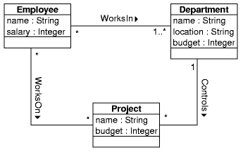
Example Model
Constraints:
The number of employees working in a department must be greater or equal to the number of projects controlled by the department.
Employees get a higher salary when they work on more projects.
The budget of a project must not exceed the budget of the controlling department.
Employees working on a project must also work in the controlling department.

Slide 3
USE specification
model Company
-- classes
class Employee
attributes
name : String
salary : Integer
end
class Department
attributes
name : String
location : String
budget : Integer
end
class Project
attributes
name : String
budget : Integer
end

Slide 4
USE specification
-- associations
association WorksIn between
Employee[*]
Department[1..*]
end
association WorksOn between
Employee[*]
Project[*]
end
association Controls between
Department[1]
Project[*]
end

Slide 5
-- OCL constraints
constraints
context Department
-- the number of employees working in a department must
-- be greater or equal to the number of projects
-- controlled by the department
inv MoreEmployeesThanProjects:
self.employee->size >= self.project->size
context Employee
-- employees get a higher salary when they work on
-- more projects
inv MoreProjectsHigherSalary:
Employee.allInstances->forAll(e1, e2 |
e1.project->size > e2.project->size
implies e1.salary > e2.salary)
context Project
-- the budget of a project must not exceed the
-- budget of the controlling department
inv BudgetWithinDepartmentBudget:
self.budget <= self.department.budget
-- employees working on a project must also work in the
-- controlling department
inv EmployeesInControllingDepartment:
self.department.employee->includesAll(self.employee)

Slide 6
Running USE
The following command can be used to invoke USE on the example specification
use examples/Demo.use
loading properties from: /home/mr/use/etc/use.properties
use version 2.1.0, Copyright (C) 1999,2000 Mark Richters
compiling specification...
Model Company (3 classes, 3 associations, 4 invariants, 0 operations)
Enter `help' for a list of available commands.
use>
use> ? Set{1,2,3}->select(e | e > 1)
-> Set{2,3} : Set(Integer)

Slide 7
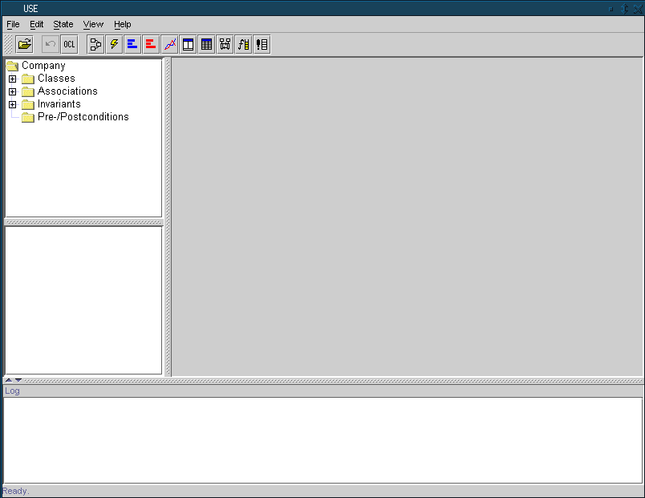
The Graphical User Interface

Slide 8
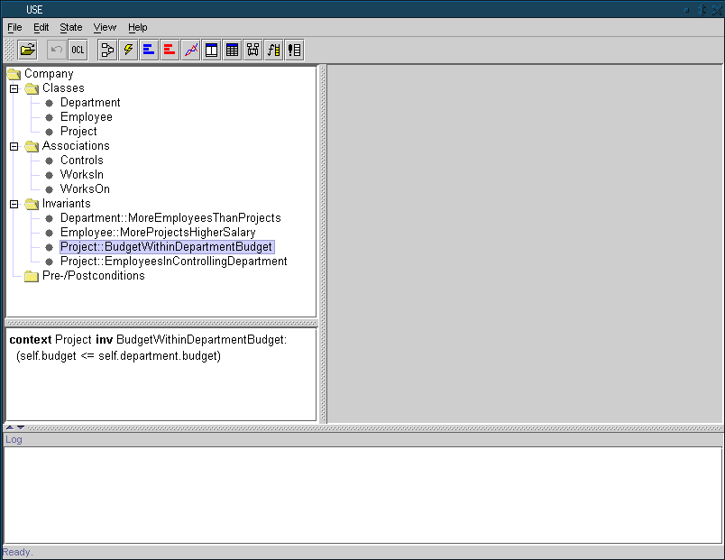
Expanded tree with all model elements

Slide 9
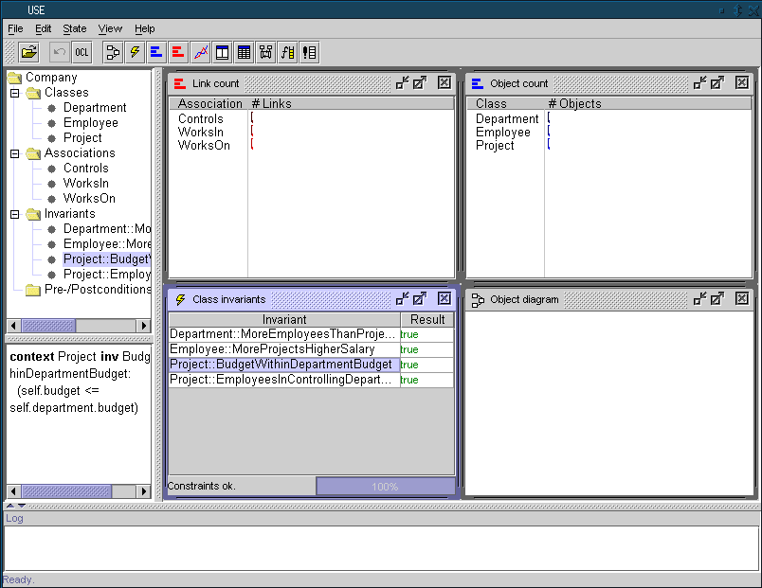
Views

Slide 10
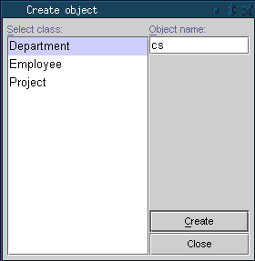
Creating Objects and Setting attributes
Objects can be created by selecting a class and specifying a name for the object
The menu command State|Create object opens a dialog where this information can be entered.
Alternatively, the following command can be used at the prompt to achieve the same effect.
use> !create cs:Department

Slide 11
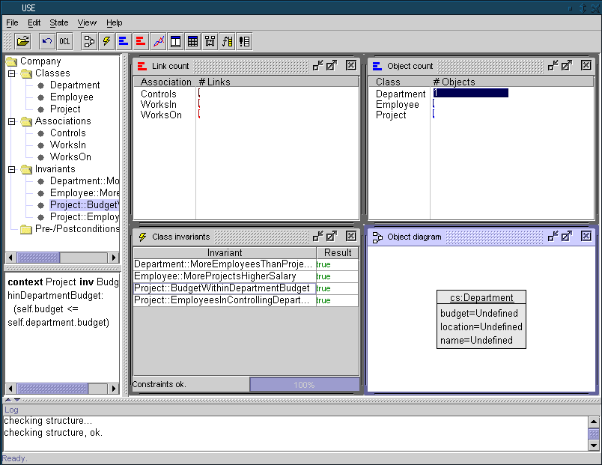
System state shown with one object

Slide 12
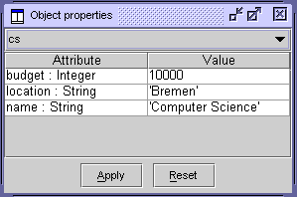
Setting attributes
For changing attribute values, we can use the set command:
use> !set cs.name := 'Computer Science'
use> !set cs.location := 'Bremen'
use> !set cs.budget := 10000
Attributes can also be changed with an object properties view.
choose View|Create|Object Properties from the View menu
select the cs object,

Slide 13
Adding two employee objects
using the command line interface:
use> !create john : Employee
use> !set john.name := 'John'
use> !set john.salary := 4000
use> !create frank : Employee
use> !set frank.name := 'Frank'
use> !set frank.salary := 4500

Slide 14
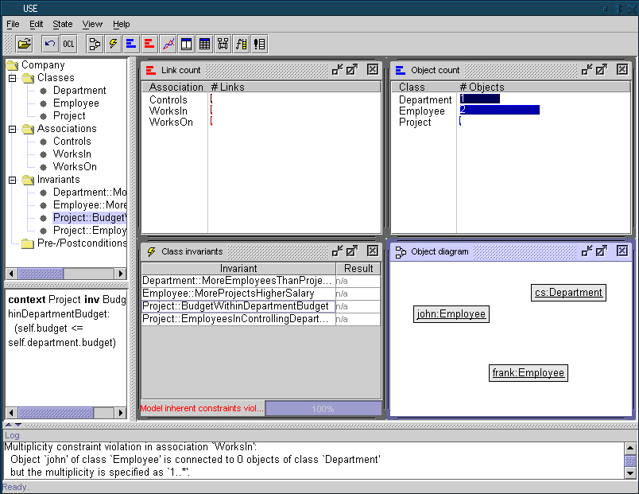
System state with three objects

Slide 15
Model Inherent Constraints
Model inherent constraints are constraints defined implicitly by a UML model (in contrast to explicit OCL constraints.
use> check
Multiplicity constraint violation in association `WorksIn´:
Object `frank´ is connected to 0 object(s) of class `Department´
but the multiplicity is specified as `1..*'.
Multiplicity constraint violation in association `WorksIn´:
Object `john´ is connected to 0 object(s) of class `Department´
but the multiplicity is specified as `1..*'.
The previous system state violates structural constraints specified in the model. This can be corrected by adding the two links:
use> !insert (john,cs) into WorksIn
use> !insert (frank,cs) into WorksIn

Slide 16
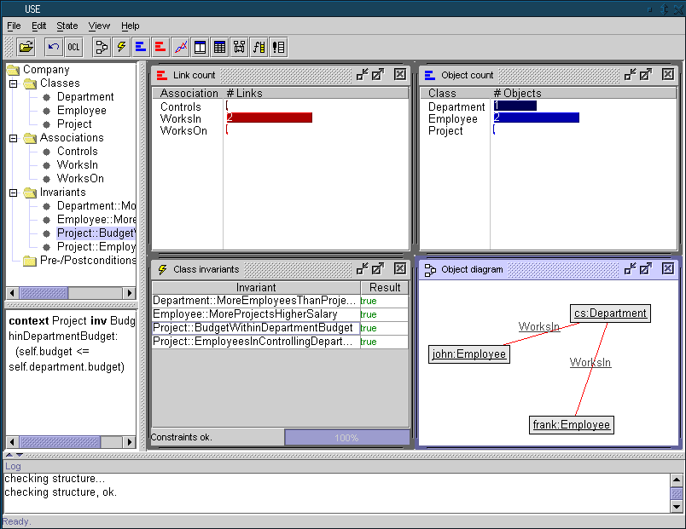
New system state shown

Slide 17
Checking OCL Invariants
adding two projects and linking them to the existing employees and the department
use> !create research : Project
use> !set research.name := 'Research'
use> !set research.budget := 12000
use>
use> !create teaching : Project
use> !set teaching.name := 'Validating UML'
use> !set teaching.budget := 3000
use>
use> !insert (cs,research) into Controls
use> !insert (cs,teaching) into Controls
use>
use> !insert (frank,research) into WorksOn
use> !insert (frank,teaching) into WorksOn
use> !insert (john,research) into WorksOn

Slide 18
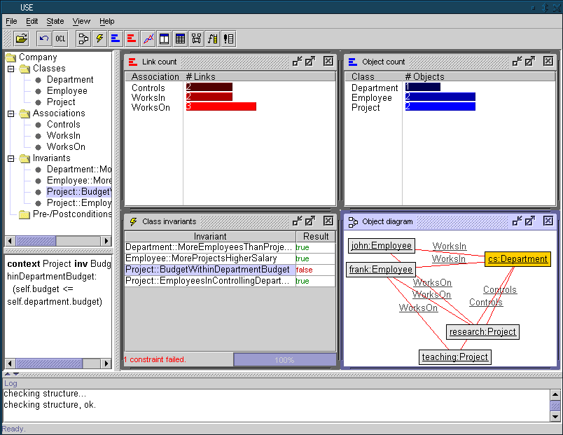
New system state shown

Slide 19
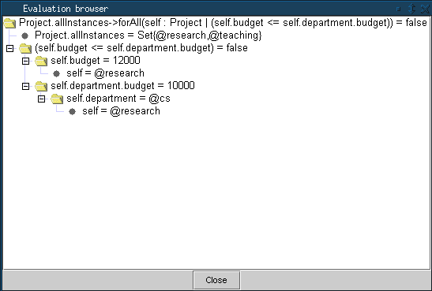
Evaluation browser

Slide 20
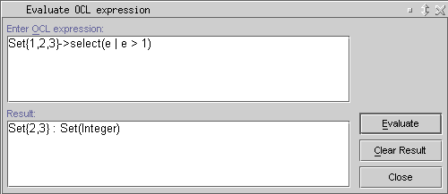
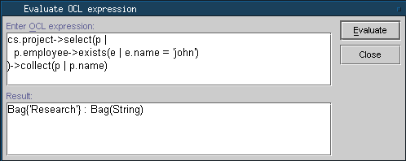
Evaluating OCL Expressions
The menu item State|Evaluate OCL expression opens a dialog where expressions can be entered and evaluated.

